Slide 1
Objectives
In this session, you will learn to:
  Identify the storage system of a PC
Notes:
Students have learnt the structure of different types of dimensions and the importance of surrogate keys in Module I. In this session, students will learn to load the data into the dimension tables after the data has been transformed in the transformation phase. In addition, students will also learn to update data into these dimension tables.
Students already know about different types of dimension tables. Therefore, you can start the session by recapitulating the concepts. Initiate the class by asking the following questions:
1. What are the different types of dimensions?
2. Define flat dimension.
3. What are conformed dimension?
4. Define large dimension.
5. Define small dimension.
6. What is the importance of surrogate key in a dimension table?
Students will learn the loading and update strategies theoretically in this session. The demonstration to load and update the data in the dimension table will be covered in next session.

Slide 2

Storage Systems
What is a storage system?

Slide 3
Storage Systems (Contd.)
A storage system is a data storage area. It stores data for future use.

Slide 4
Storage Systems (Contd.)
The storage system consists of three parts:
  Medium: Is a device to store data.
  Drive: Is a mechanism that operates the medium.
  Controller: Is commands that controls the drive.
  The different types of storage system are:
  Floppy disk
  Hard disk
  Compact disk
  Magneto-optical disk

Slide 5
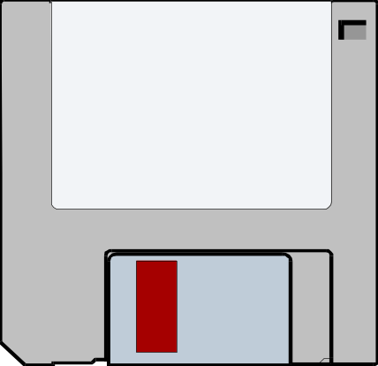
Floppy Disk System
Let us see a floppy disk.
Write Protect Tab
Hard Cover Jacket
Paper Label
Media Cover

Slide 6
Floppy Disk System (Contd.)
Floppy disks are circular in shape.
Floppy disks have a hole in the center, called the clamping hole.
The clamping hole is covered with a square protective jacket.
The jacket has an oval slot, called the head slot.
The head slot exposes a portion of the disk surface.
The index hole is the starting point of the disk.
The drive contains a spindle mechanism for rotating the disk.

Slide 7
Floppy Disk System (Contd.)
The drive contains the read-write head.
The read-write head accesses the disk surface through the head slot.
Head slot also helps in retrieving and storing the data.
The factors that determine the storage capacity of a disk are:
  Number of tracks and sectors
  Number of sides on which data is recorded
The floppy disk drives can be double-density or
high-density drives.

Slide 8
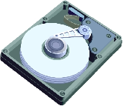
Hard Disk System
Let us see a hard disk.

Slide 9
Hard Disk System (Contd.)
The hard disk:
  Is made up of a collection of disks known as platters.
  Is located inside the system unit.
  Has a read-write mechanism located over the recording surface.
  Controller performs functions similar to that of a floppy disk controller.

Slide 10
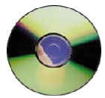
Compact Disk System
Let us see a compact disk.

Slide 11
Compact Disk System (Contd.)
Compact Disk-Read Only Memory (CD-ROM):
  Is a very popular storage medium.
  Can store data up to 700 MB or more.
  Can be written by using a special device, called the
  CD-Recorder.

Slide 12
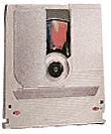
Magneto-Optical Disk System
Let us see a
magneto-optical disk.

Slide 13
Magneto-Optical Disk System (Contd.)
A Magneto-Optical (MO) disk:
  Is a reliable media for long-term data storage extending to over 30 years.
  Can resist dust, magnetic fields, Ultra Violet rays, and X-rays.
  Is used for transferring large volumes of data. It is used to store information in various industries.

Slide 14
Summary
In this lesson, you learned that:
  Storage System inside a PC consist of three logical parts:
    Medium
    Drive
    Controller
  The different types of storage system are:
    Floppy disk
    Hard disk
    Compact disk
    MO disk
  Hard disk is located inside the system unit.
  CD-ROM is most popular storage media.
  MO disks are a reliable media for long-term data storage extending to over 30 years.

Slide 15
Home Assignment
Let me give you some questions to solve at home.

